Slide 1
MAJOR PROJECT

Slide 2
LIP READING USING NEURAL NETWORKS & DEEP LEARNING
.

Slide 3
AKASH CHANDRA (20071A0569) CHARITHA PARUCHURI (20071A0570) KARTHIKAAWALGAONKAR (20071A0581) YOGITHA(21075A0511)
TEAM MEMBERS:
Guide name :Mr.Bheemalingappa

Slide 4
ABSTRACT:
Lip reading is a technique to understand words or speech by visual interpretation of face ,mouth and lip movement without the involvement of audio.
This task is difficult as people use different dictions and
various ways to articulate a speech.

Slide 5
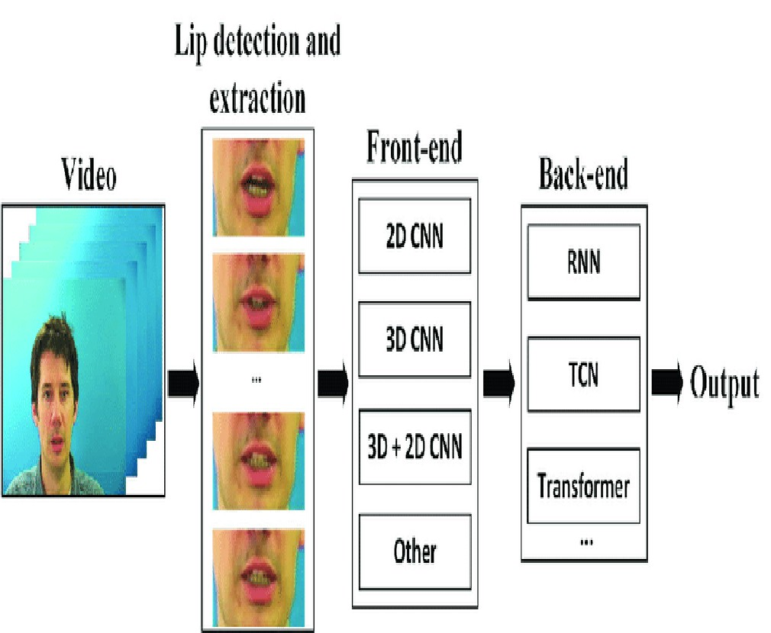

This project verifies the use of machine learning by applying deep learning and neural networks to devise an automated lip- reading system.

Slide 6
Lip reading is a challenging and recent topic, even for expert lip readers, but with deep learning methods offer potential solutions.
INTRODUCTION
:
Improved lip reading technology can enhance speech recognition in noisy environments and benefit people with hearing disabilities using hearing aids.

Slide 7
Lip reading systems can be applied for speech analysis in security scenarios when audio is corrupted or absent in videos.
Creating a computer program for accurate lip reading is difficult due to language variations and differences in diction.
The project utilizes neural networks train andevaluate lip reading architectures, leading to a real-time lip-
reading web application with enhanced accuracy.

Slide 8
TITLE | OBJECTIVES | METHODOLOGY/INFERENCES | PROS/CONS | CONCLUSIONS
Lip readi ng sente nces usi ng deep learning with only visual c ues(2020) | improve the accuracy of lip reading sentences address the limitations of word- based approaches, optimize the models to cover a wide range of vocabulary. | Classification Using Visemes: . Visem es are distinct lip movements that correspond to sp eech sounds. This reduces the numbe r of classes compared to using words or ASCII characters. Specially Designed Deep Learning Mode l: They develop a deep learning model specifically designed for cl assifying visemes. Conversion to Recognized Words: After classifying visemes, a conversion process is employed to map recognized v isemes to possible words. This conversio n involves perplexity analysis, a techniq ue used to determine the likelihood of di fferent word sequences given the observ ed visemes. | Pros:Viseme- based lip reading d oesn't require pre- trained lexicons, Cons: Visemes tend to have shorter du rations than wo rds need to perform a viseme-to- word conversion , which introduc es complexity. | The conclusion of the study highlights the successful development of a neural network-based lip reading system that significantly improved word classification accuracy in silent videos, with future research directions focusing on improving generalization and efficient viseme-to- word conversion.

Slide 9
Deep learning base d automated lip rea di ng : survey(2021) | Incorporate visual cues, such as lip movements, to enhance audio signals for better speech reception Overcoming Audio-Only Limitations To improve perceived overall speech quality | Datasets like such as LRS2 , LRS3- TED ,LSVSR have beencompiled from h ours of programmes that have been st reamed on the BBC, TEDX and YouTub e like are sampled into image frames r epresenting speech to be decoded.Basi c transformations like cropping are applied to reduce computational c omplexity and after that; Convolution alNeural Networks (CNNs) are common ly used for feature extraction because they are better at learning both spatia l and temporal features.The extracted features in classification, where spee ch is transcribed to facial movements t hat havebeen transformed into a lower dimensional feature vector.Recurrent Neural Networks (RNNs), including Lon g- Short Term Memory networks (LSTMs) and Gated Recurrent Units (GRUs), ar e often used for sequence processing and classification. The output of the classification step represents speech in class es or units, which are eventuall y encoded as spoken words or s entences. | PROS: The use of 2D+3D CNNs for feature extraction iseffective for capturing spatial and temporal features The phonemes and visemes as clas sification schemas suggests the p otential for lexicon-free lip- reading systems. CONS: Preprocessing which includes face d etection, lip extraction, and classification of phonemes and visemes add co mplexity to the system Visual ambiguities can arise, where w ords that look the same when spoken have similar visual representations, making them challenging to distingui sh. | the survey highlights the progression of automated lip-reading systems from traditional algorithms to deep neural networks, driven by advanced corpora, and the challenges that still exist, including predicting unseen words, handling visual ambiguities, and generalizing to different speakers and video characteristics.

Slide 10
Lip Reading D riven- Deep Learnin g Approach Fo r speech enh ancement(202 1) | Developing a deep learning- based lip-reading regression model to estimate clean audio features using visual data. Creating an enhanced, visually-derived Wiener filter (EVWF) for estimating the clean audio power spectrum | The paper presents a novel deep learni ng-based lip- reading regression model for speech enhancement. It uses a stacke d LSTM model to estimate clean audio features from visual lip movements The Enhanced Visual Waveform (EVW F) model that integrates audio and vi sual cues to enhance speech.The EV WF employs an inverse filterbank tra nsformation for audio power spectru m estimation.Unlike some existing m ethods, the proposed approach elimi nates the need for voice activity detection (VAD) and no ise estimation.It evaluates the proposed ap proach using benchmark audio- visual corpora and real- world noisy scenarios, including variou s noise types and signal-to- noise ratios (SNRs). | PROS: The proposed EVWF em ploys an inverse filter- bank transformation. The EVWF eliminat es the need for voi ce activity detectio n (VAD) and noise estimation, simplify ing the processing pipeline. CONS: I generalization testing with unfamiliar speak ers and the use of nov el visual features, req uire additional resourc es and efforts. | The conclusion of the paper highlights the development of a novel audio-visual speech enhancement framework, showcasing the improved performance of their deep learning-driven AV approach, while acknowledging the need for further evaluation, especially in realistic scenarios and with benchmark speech enhancement approaches. Future work involves developing a context-aware AV system and new evaluation frameworks for AV algorithms.

Slide 11
Deep neural ne twork for auto mated lip readi ng visual speec h recognition(2 019) | Enhance speech recognition in noisy environments. Assist security forces in identifying speech when audio records are unavailable. Extract text words from a video input using visual lips tracking and Deep learning techniques. | This paper introduces the concept of vi sual speech recognition, which involve s understanding speech by observing lip movements without relying on acoustic signals. This approach is particularly useful in noisy environments and situations requiring priva cy. The input video is converted into a sequence o f frames.This step involves face and lip detecti on. The frames are converted to grayscale ima ges and resized, reducing their size to improve processing speedFace detection is performed using Haar feature- based classifiers, and if a face is not detected, a profile face detection is attempte d. Lip detection is then performed. Tracking is employed for subsequent frames, using the M edianFlow Tracker from the OpenCV library.Gr ayscale images of the mouth region are extract ed and resized for each frame, resulting in a t ensor of dimensions 28×24×32. These features are used for model training.A deep learning m odel is trained using Keras and TensorFlow and at last Model evaluation is performed using a confusion matrix to assess the accuracy of word prediction. | Pros: The grayscale conversi on and resizing of fram es help speed up the training proces s by reducing data di mensionality and incopor ation of mu ltimodality Cons: The framework's perform ance in real- world scenarios or nois y environments is not discussed | This paper concludes that, lip reading is a valuable solution for individuals with hearing difficulties and mute people, enabling them to engage in social activities and communicate effectively. The interest in automatic lip-reading technology has grown due to the benefits of visual speech cues, aiming to enhance automatic speech recognition by utilizing informative visual features from the speaker's mouth region. This technology involves various components, including lip region detection, feature extraction, recognition methods, fusion techniques, mouth classification, and data set training.

Slide 12
Lip readin g using CN N and LST M(2020) | addresses the challenge of varying sequence lengths by employing three different methods to capture temporal information formulation of a classification task to detect the spoken words or phrases from a fixed set of known options | The proposed system mentions 3 feature extraction methods VGGNet with Concatenation: A fixed number of images from each sequence are concatenated into one larger im age. VGGNet with Interpolation: Similar to Method 1, but nearest neighborinterpolation is used to stretc h and normalize the number of image s persequence. and LSTM with VGGNet Features: Individual images are passe d through the VGGNet to extract feat ures. These sequencelevel features ar e then processed by several LSTM layers, and the classification label is obtained from the final output | Pros: The framework addresses the challenges of variable- length input sequences effectively Cons: The LSTM model, especially when updating the VGGNet simultane ously, had a long training time andThe LSTM model extracts f eatures after the initial featur e extraction stage, potentially missing out on some temporal i nformation | This paper concludes that best- performing model in our study was the concatenated model using interpolation, which effectively utilized available input data and was invariant to speaking speed. However, the model trained from scratch underperformed due to the small dataset and the similarity of features to those in a single face photograph.

Slide 13
Discrimina tive multi modality speech re cognition( 2019) | Introduce the P3D as visual front-end upgrade the temporal convolution block of 1D ResNet to a TCN one in AE sub-network . 3 Extensive experiments To show that AE- MSR surpasses state-of-the-art MSR model | The framework is implemented by a n audio- enhanced multi- modality speech recognition (AE- MSR) model with double visual awar eness The AE- MSR model comprises two sub- networks: the audio enhancement (AE) sub- network and the MSR sub- network. In the first stage, the AE sub- network reconstructs the audio si gnal by using visual information (lip movements) to i solate the target speaker's voice . Followed by second stage, the enhanced audio m odality is combined with th e visual modality for improved speech recognition and TCN replaces the temporal co nvolution block of 1D ResNet in th e AE sub- | Pros: The framework leverages sub- modules like Pseudo 3D Residual Convolution (P3D), Tempor al Convolutional Network ( TCN), Cons: The enhanced architecture a nd extensive training may re quire significant computational res ources and time | The study presents the AE-MSR network, demonstra ting the importance of double visual awareness in improving MSR performance, especially in noisy settings. Furthermore, the models showcased in this paper exhibit performance advantages over state-of-the-art models on the LRS3- TED and LRW datasets.

Slide 14
Visual spee ch re cogn ition for multiplelan guages in t he wild(20 22) | Improve Visual Speech Recognition (VSR) by emphasizing on model design . underscore the importance of hyperparameter optimization | The proposed approach introduce the VSR model enhanced with aux iliary tasks, enabling it to simulta neously perform VSR while predicting audio and visual repres entations. Hyperparameters are optimi zed and language models is conducted to extract maxim um performance from the m odel, without the need for a dditional data. Time- masking is introduced which is a temporal augmentation technique commonl y used in Automatic Speech Reco gnition (ASR) models, enhances V SR performance. It forces the mo del to consider contextual inform ation, aiding in distinguishing similar lip move ments corresponding to different phonemes | Pros: the incorporation of predi ction- based auxiliary tasks an d time- masking techniques cont ributes to a substantial r eduction in word error ra te (WER Cons: One potential drawback is that the model may require extensi ve hyperparameter optimi zation, which can be a tim e-consuming and resource- intensive process. | The conclusion highlights the success of the presented VSR approach, emphasizing the significance of model design, hyperparameter optimization, time- masking, auxiliary tasks, and the use of larger datasets in achieving superior performance compared to existing VSR models across multiple languages.

Slide 15
Training strategi es for i mproved lip read ing(2022 ) | Investigate the potential of combining various training strategies Identify the most effective data augmentation technique 3.Improve classification accuracy on the LRW dataset, achieving a 4.6% absolute improvement | Exploration of three different temporal model s: BGRUs, MS-TCNs, and DC- TCNs, which are essential for re cognizing isolated words. These models capture temporal depe ndencies and enable accurate word classificat ion. It also introduces various traini ng strategies like Data augmen tation techniques are also utilized to improve model robus tness. Frame flipping randomly flips all frames in a video with a 0.5 probability. Mixup generates augmented training examples by linear ly combining two inputvideo sequences and their corresp onding targets and self- distillation involving the training of teacher and student m odels with | Pros: The paper incorporates va rious data augmentation technique s such as random croppi ng, flipping, mixup, and time masking. These a ugmentations enhance the robustness of the m odel Cons: Fine- tuning hyperparameters can be a time- consuming and the Fra mework excels on LRW dataset it cannot be generalised to other datasets | The paper concludes the significance of Time Masking and mixup as key data augmentation methods, the superiority of DC- TCNs over MS-TCNs and BGRUs, the positive impact of self- distillation and word boundary indicators on classification accuracy, and how pre-training leads to a slight improvement, ultimately improving the accuracy of recognizing hard-to- recognize words.

Slide 16
Leveragi ng Unim od al Se lf- Supervis ed Lear nin g for Multi modal Au d io- Visual Sp eech Re co gniti on (2022) | Addressing the challenge of acquiring labeled data for audio- visual speech recognition Leveraging large- scale unimodal self- supervised learning to improve multimodal audio-visual speech recognition Training audio and visual front-ends on unimodal datasets Developing a model that recognizes parallel audio-visual data into characters | The framework in this paper fo cuses on Audio- Visual Speech Recognition (AVS R) and leverages self- supervised learning to enhance performance. It inc orporates pre- trained models from massive u nlabelled single- modality data to improve both the audio and visual front-ends for AVSR. The audio front- end utilizes a pre- trained model from the Libri- Light dataset, which consists o f 60K hours of audio signals. Th e visual front- end involves adapting a pre- trained MoCo v2 model with a 3 - D convolutional layer fine- tuned using the LRW dataset. This approach eliminates the n eed for curriculum learning an d reduces training time. | Pros: 1.Leveraging on Unimodal Self- Supervised Learning in multimodal environme nts to improve AVSR Cons: Complexity of model modif ication | paper highlights the successful utilization of self-supervised learning for Audio-Visual Speech Recognition (AVSR), resulting in an impressive 30% relative improvement, particularly in the audio modality due to the larger training data scale. The authors also discuss future directions in self-supervised learning, aiming to explore temporal correlations in the visual domain and cross-modal correlations between audio and visual,

Slide 17
Lip Readi ng using Neural Ne twork an d Deep le arning(20 19) | Addressing Gaps in Existing Approaches Exploration of Performance Metrics Real-world Applicability | A subset of the dataset was trained on two separate CNN architectures.. The Haar feat ure- based classifier is used to detect objects in the images.The algorithm required a set of positive images (frontal face with mo uth visible) and negative images (non- frontal face) to train the classifier. Then, t he specific feature (ROI) was extracted fro m the image. Convolutional Neural Network (CNN ) is a class of Neural Network system in a s tandard multi-layered network.Oxford- BBC LRW dataset used for training it consist s dataset consists of short video clip segments of 1.16 seconds (appro ximately 29 frames) and contains 500 differ ent word instances with up to 1000 utteranc es for each word spoken by different speak ers. It was generated using a multistage pip eline for a specific purpose of audio- visual speech recognitionThe techniques lik e Dropout is used which isregularization technique that helps to red uce overfitting and improve the generalizat | Pros: Security applicati ons Cons: limited lip re ading accur acy diverse language challenge | In conclusion, the developed neural networkfor lip reading, based on ResNet and GRU networks, dem onstrates promising accuracy over 90% on the BBC dataset, while identifying areas for further exploration, such as improved performa nce with subjects havingfacial

Slide 18
Lip reading Using Facial Feature Extr action and D eep Learning (2021) | 1.Facial Feature Extraction 2.Enhanced Word Recognition 3.Adaptability to Varied Environments | Long- Short Term Memory is a way to help sol ve the issue, in conjunction with facial feature extraction to optimize the pro cess. Color imaging combined with dep th sensing helps in additional improve ment to the accuracy of the classifier.A nd a Facial Expression Recognition algo rithm to identify face values, using the se algorithms the program detects for s pecific regions of the face and tracks t heir movement.Convolutional neural ne tworks are very good at picking up on patterns in the input image, such as lines, gradient s, circles, or even eyes and faces. Unli ke earlier computer vision algorithms, convolutional neural networks can oper ate directly on a raw image and do not need any preprocessing, whereas in th e case of Long Short- Term Memory(LSTM) is an artificial RNN architecture that has feedback connections. It can not only process singl e data points (such as images), but also | Pros: The utilization of Long- Short Term M emory (LSTM) Facial Feature Extraction Multimodal In tegration: Cons: Data requiremen ts Limited Gener alization | In summary, our study introduces a robust lip reading system, leveraging facial feature extraction and deep learning, showcasing improved word recognition accuracy and real-time applicability. The model's adaptability to diverse environments underscores its potential for practical use in enhancing accessibility for individuals with hearing impairments

Slide 19
LIPNET: END- TO-END SENTENCE- LEVEL LIPREADING(2 016) | Challenges in Human Lipreading Automating Lipreading Comparison with Hearing-Impaired Individuals Interpreting LipNet's Behavior 5.Viseme Confusion Analysis | the proposed framework uses an end-to- end sentence-level lipreading model called LipNet, which uses spatiotemporal convolutional neural networks (STCNNs), recurrent neural networks (RNNs), and the connectionist temporal classification loss (CTC). It achieves a 95.2% sentence- level word accuracy on the GRID corpus, outperforming previous methods, and generalizes well across unseen speakers. LipNet's accuracy surpasses that of hearing-impaired individuals, demonstrating its practical potential in various applications. Additionally, the model's behavior is interpreted using saliency visualization, revealing its attention to phonologically important regions in the video and indicating that most errors occur within visemes due to insufficient contextual information. . | Pros: LipNet, can achieve significantly higher sentence- level word accuracy compared to hearing-impaired individuals The model's behavior focuses in the video, enhancing transparency. Cons: Machine lipreading is difficult due to the need to extract spatiotemporal features from video data LipNet's few erroneous predictions occur within visemes | The paper highlights the success of LipNet, an end-to-end model for mapping image sequences of a speaker's mouth to sentences, which outperforms human lipreading and word-level state-of-the- art models and suggests the potential for even better performance with more data and the expansion of applications to audio-visual speech recognition in noisy environments.

Slide 20
Combining Residual Networks with LSTMs for Lipreading(2017) | Complement Audio-Based Speech Recognition Transition from Handcrafted Features to Deep Learning Categorization of Approaches | this study focuses on visual speech recognition, or lipreading, which complements audio-based speech recognition. It utilizes deep learning methods and falls into the category of modeling words. The system combines three sub-networks: a spatiotemporal convolutional front-end, a Residual Network (ResNet) applied to each time step, and a two-layer Bidirectional Long Short-Term Memory (Bi-LSTM) network in the backend. The SoftMax layer is applied to all time steps, and training is done in an end-to-end fashion. The system performs not only word recognition but also implicit keyword spotting. The paper is organized into sections covering recent works in visual speech recognition, database discussion, model details, and experimental results. . | Pros: detailed description of the proposed system, including the three sub-networks involved performs implicit key-word spotting Cons: does not utilize word boundary information Limited Discussion of Dataset | The paper conclude s the growing attention in visual speech recognition (lipreading), its applications, the impact of deep learning, and the description of the proposed system, which focuses on word recognition and implicit keyword spotting using an end-to-end approach.

Slide 21
LEARNING AUDIO-VISUAL SPEECH REPRESENTATIO N BY MASKED MULTIMODAL CLUSTER PREDICTION(202 2) | Importance of Multimodal Speech Perception: Incorporating Visual Information into Machine Learning Models: Introduction of AV-HuBERT and its architecture | The paper proposes a self-supervised speech representation learning framework called AV-HuBERT, which utilizes both audio and visual information from lip movements to capture cross- modal correlations. The model is designed to improve tasks like lip reading and automatic speech recognition, particularly in low-resource settings. AV-HuBERT combines audio and visual data, and its contextualized representations show excellent transferability to lip-reading tasks, outperforming previous models. Additionally, the multimodal clusters derived from AV-HuBERT can enhance audio-based speech recognition, demonstrating the model's versatility and potential applications in various domains. . | Pros: Integrating audio and visual lip movement information AV-HuBERT demonstrates the transferability of representations to lip-reading tasks Cons: 1.limited dataset availability | The paper highlights the successful development of Audio-Visual Hidden Unit BERT (AV-HuBERT), a self- supervised speech representation learning framework that utilizes audio and visual information from lip movement to improve lip reading and automatic speech recognition tasks, demonstrating its effectiveness in low-resource settings and achieving new records in lip-reading word error rate.

Slide 22
SPOTFAST NETWORKS WITH MEMORY AUGMENTED LATERAL TRANSFORMERS FOR LIPREADING(202 0) | Exploring the potential of using pretrained deep 3D Convolutional Neural Networks (3DCNNs) Introducing SpotFast networks, a variant of SlowFast networks, that combines temporal and frame-based pathways for feature extraction. Incorporating memory augmented lateral transformers significant improvement (3.7%) achieved by incorporating memory augmented lateral transformers into the SpotFast networks. | this paper focuses on word-level automatic lipreading, aiming to recognize spoken words solely from lip movements in a video sequence. The standard lipreading pipeline includes mouth region cropping, compression, and sequence modeling. The current state-of- the-art system combines 3D Convolutional Neural Networks (3DCNNs) for feature extraction and bidirectional Long-short Term Memory (biLSTM) for classification. The proposed approach integrates the strengths of both methods by using a variant of 3DCNNs, SpotFast networks, to model fast lip gestures, and introduces memory-augmented lateral transformers to capture temporal sequential information. This approach achieves a new state-of-the-art for word-level lipreading using only RGB/grayscale input, and the paper evaluates the impact of different temporal window sizes on the SpotFast networks.. . | Pros: combines the strengths of different approaches, using the SpotFast network Dual Temporal Convolution 3.Memory Augmented Lateral Transformers Cons: Resource- Intensive Lack of Real- World Use Cases | The study suggests that their proposed SpotFast networks with lateral transformers and a heuristic-based approach for selecting the optimal temporal window size significantly improved word- level lipreading accuracy by 3.7% and outperformed various state-of-the-art models, with potential future directions including incorporating optical flow input and increasing augmented-memory capacity.

Slide 23
Automatic li p reading u sing CNN an d Bidirectio nal LSTM(20 18) | introduces model- based methods, such as active appearance model (AAM) and active shape model (ASM), which aim to extract high-level geometric features with greater robustness. propose a hybrid neural network architecture that combines CNN and Bidirectional LSTM (BiLSTM) | The first stage of the framework involves e xtracting relevant features from lip move ment videos. Two classes of feature extraction me thods are discussed: pixel- based methods and model- based methods. Pixel- based methods use pixel values from the m outh region of interest (ROI) and apply dimensionality red uction techniques like DCT, DWT, or PCA. Model- based methods, on the other hand, create non- rigid models (e.g., AAM, ASM) to capture h igh- level geometric featuresAfter feature extr action, the extracted features are fed into classification models like Hidden Markov M odels (HMM) CNN and Bidirectional LSTM ( BiLSTM) to learn hidden correlations and inputs sequential information in both spatial and temporal information and softmax layer is used for final recognition | Pros: Key frame extraction and mouth region localization h elp reduce redundant informati on in consecutive frames, improving computati onal efficiency. Cons: The experimental results are based on a self- established database, whi ch may lack diversity and scale compared to widel y used benchmark datase ts. | The concludesion is that the hybrid neural network, combining CNN and BiLSTM for lip reading, outperforms traditional methods and has potential for future development, including speaker-independent lip reading.

Slide 24
TOWARDS PRACTICAL LIPREADING WITH DISTILLED AND EFFICIENT MODELS(2021) | Address the computational cost limitations of current deep learning models for lipreading Utilize Knowledge Distillation (KD) to provide inter- class similarity information. Apply the KD framework to mitigate the performance | They employ Knowledge Distillation (KD) to train lightweight models without a substantial decrease in performance. A sequence of teacher- student classifiers is used, where the student architecture becomes the teacher in the next generation until no further improvement is observed. Additionally, they propose a novel lightweight architecture that replaces the ResNet-18 backbone with efficient alternatives like MobileNet or ShuffleNet. They use depthwise separable convolutions to reduce parameters and FLOPs, and they design a variant of Temporal Convolutional Networks using these convolutions. . | Pros: developing lightweight models without significant decreases in performance Knowledge Distillation (KD) is employed for better classification. depthwise separable convolutions, reduces the number of parameters and FLOPs Cons: 1. Computational cost remains a major limitation | The paper highlights state-of-the-art results in isolated word recognition through knowledge distillation, efficient models for visual speech recognition with reduced computational cost, and suggests exploring cross- modal distillation's impact on audiovisual speech recognition in future work.

Slide 25
Lip rea ding u sing Te mporal neura l netw orks(2 020) | Developing a Lipreading Model Improving Temporal Feature Learning Handling Variability in Speech Patterns Cross- Institutional Collaborat ion Real- world Applicability | Firstly, the BGRU layers are replaced withTemporal Convolution al Networks (TCN). the training procedure is si mplified, which allows us to train the model in one single stage. Thirdly, it shows that the cur rent state-of-the- art methodology produces models that do not generalize well to variations on the sequence length,and address this issue by proposing a variable- length augmentation.Traditionally, a two- stage approach was followed where features were first extracted from the mouth region, w ith the Discrete Cosine Transform being the most popular feature extractor, and then fed to a Hidden M arkov Model (HMMs)for modeling of the tempo ral dynamics. The training procedure is simplified , reducing tra ining time from3 weeks to 1 week GPU- time, and avoid relying on a cumbersome 3- stage sequential training.They used the Lip Readi ng in the Wild (LRW)and LRW1000 databases whi ch are the largest publicly available lipreading da tasets in English and respectively, in the wild | Pros : Simplified Training Procedure Replacement of BGRU with TCN Cons: The framework ac hieves results on L RW and LRW-1000 datasets | In conclusion, the developed neural network for lip reading, based on ResNet and GRU networks, demonstrates promising accuracy over 90% on the BBC dataset, while identifying areas for further exploration, such as improved performance with subjects having facial hair.

Slide 26
Visual Speech Recogn ition: A Deep Learnin g Appr oach(20 20) | 1.end-to-end approach 2.Scalability and Generalization 3.Evaluation Metrics and Benchmarking | The proposed visual speech recognition a pproach has used the concept of deep learning to perform word- level classification. ResNet architecture i sused with 3D convolution layers as the e ncoder The two major aspects of Visual S peech Recognition are Natural Language Processing (NLP) and Computer Vision (CV). The proposed approach consists of 3 phases which are preparing the datase t, lip detection, and feature extraction and prediction on unseen visu al data. The input is given as a video fro m where the model extracts the spatial and temporal features for pr ediction. OpenCV and a machine learning model is use d for the preparation of the dataset. Here, t he main focus is to extract the Region of Interest (ROI) i.e. the area around the lips. The proposed model has been deployed on a local server to test vari ous video inputs. The model is further trained b y extending the vocabulary. | Pros Multimodal Approach Use of Large Dataset 3.Encoder- Decoder Architectur e Cons: Vanishing Gradient Probl em: training difficulties, especially when using deep learning models with man y layers. Resource Requirements: ResNet a nd GRU can be computati onally intensive | In conclusion, this work successfully presents an end-to-end approach for word identification using visual input, employing a computationally efficient ResNet model and GRU networks. While achieving over 90% accuracy on the BBC dataset and 88% on a custom dataset, challenges remain with subjects having facial hair, indicating potential areas for further exploration and refinement

Slide 27
Artificial Intelligenc e: A surv ey on lipr eading Te chniques( 2019) | combining both audio and visual clues for enhanced speech recognition Focus on improving biometric security applications and discussing various models, datasets | The paper talks about how lip reading syste m mainly consists of three parts: lip detecti on and localization, lip feature extraction a nd lip reading recognition . The lip localization and detection techniques ar e Gray/color information- based methods where color information is used to locate lips, Geometric information- based methods where rough region of mouth is calculated correspondi ng to the proportion of the face Feature Extraction Method Traditionally, there a re two categories of the feature extraction met hod in a lip reading system: pixel- based methods and model-based methods The recognition methods of lip reading are template matching, Hidden Mark ov model (HMM) Dynamic Time Warping (DTW), Artificial Neural Networks (ANN), DL architectur es. | Findings: It is observed that CNN, HMM, LSTM, DNN these techniques are used widely are used do minantly these days an d also gives good result. HMM has hidden st ates and it is represented as simple dynamic Bayesian network Cons: Other challenges associated to lip- reading include Light condit ions, conditions, head pose variations, poor temporal r esolution. Classifying them by task (e.g. letters, digits)and by viewing angle. | The paper concludes that deep learning techniques, especially those combining Convolutional Neural Networks (CNN) with Long Short-Term Memory (LSTM), have shown significant performance improvements in lip reading. It also highlights the availability of various types of datasets in multiple languages and suggests the potential for creating datasets for regional languages

Slide 28
EXISTING SYSTEM
Feature Extraction: Early approaches relied on hand-crafted features, but deep learning models can now automatically extract informative features from lip movements in video sequences
2. Model Architectures: Architectures like SpotFast, and AV-HuBERT incorporate various strategies like temporal convolutions but a critical challenge is ensuring models perform well beyond controlled lab settings.
3.Employing only single modality: Single modality lip reading refers to the use of only visual information from lip movements and facial cues for speech recognition
4. Computational Cost: Complex models often require significant computational resources, hindering deployment on mobile devices or real-time applications.
5. Limited Datasets: Training robust lip-reading models requires large datasets with accurate lip-to-speech annotations.

Slide 29
PROPOSED SYSTEM
Implementing multimodality:
It refers to integrating multiple sources of information, such as visual data (lip movements and facial cues) and audio data, to improve the accuracy and robustness of lip reading systems. This makes it more resilient to noisy environments and improving overall performance
2. Sentence-Level Prediction: Unlike previous approaches that focused on word classification, LipNet performs sentence-level sequence prediction, capturing temporal context and improving performance, especially for longer words

Slide 30
OBJECTIVES
01
1. Improved Speech Recognition: Deep learning models can be trained to interpret lip movements and predict spoken words
02
2. Assistance for Hearing- Impaired Individuals: It can aid people with hearing disabilities by providing real-time transcription of spoken words into text.
03
3. Robust Communication in Noisy
Environments: used in
scenarios where audio- based communication is hindered by
excessive noise.
04
4. Multimodal Integration: The
objective is to integrate lip movements with audio signals using deep learning can create a more robust and accurate system.

Slide 31
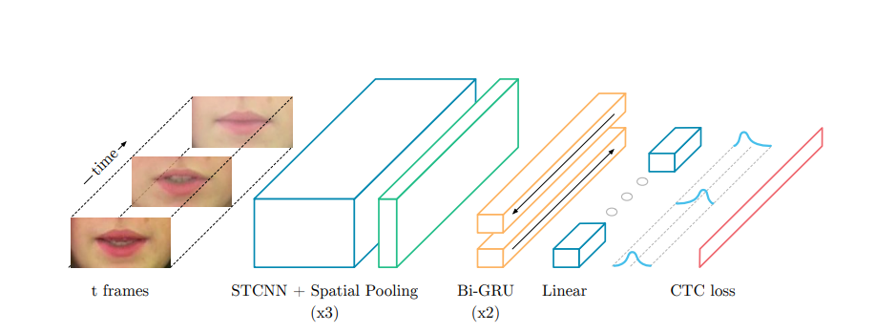
SYSTEM ARCHITECTURE
Framework for automated lip reading
Lip detection process

Slide 32
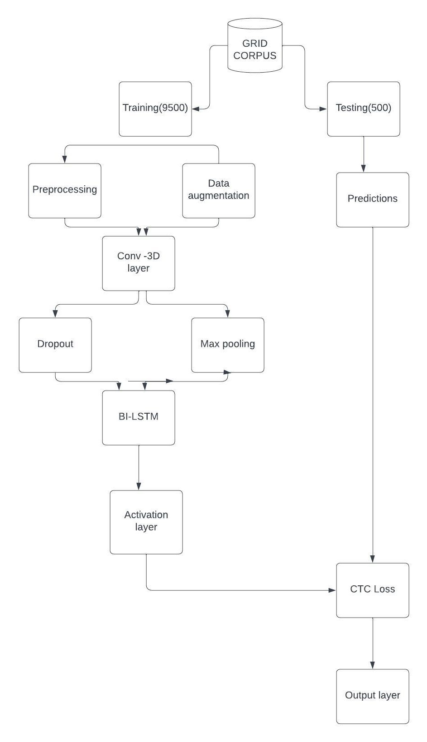

Slide 33
1. Feature Extraction:
- This stage uses a series of three convolutional layers to capture both spatial (lip shape) and temporal (lip movement) information from the video sequence.
- Each convolutional layer is followed by:
- Channel-wise dropout: This technique randomly drops a certain percentage of activations from each channel in the feature map, helping to prevent overfitting.
- Spatial max pooling: This operation reduces the dimensionality of the feature maps by selecting the maximum value from a window of pixels.
2. Sequence Modeling:
- The extracted features are then fed into two Long Short-Term Memory (LSTM) networks. LSTMs are a type of recurrent neural network (RNN) capable of learning long-term dependencies in sequential data, which is crucial for lip reading as it involves understanding the order of lip movements.

Slide 34
3. Prediction:
- Finally, a linear transformation is applied at each time step of the LSTM outputs. This transforms the data into a format suitable for the next step.
- A softmax function is then applied over the vocabulary augmented with a special "blank" symbol used in connectionist temporal classification (CTC) loss. The soft max function outputs a probability distribution indicating the likelihood of each word in the vocabulary (including the blank symbol) at each time step.
- CTC loss is a function that calculates the difference between the predicted sequence and the ground truth (actual spoken sentence). It is particularly useful for lip reading tasks because it can handle variations in speaking rate and doesn't require perfect alignment between the video frames and the words being spoken.
All layers in the LipNet architecture use ReLU (Rectified Linear Unit) activation functions. ReLU functions introduce non-linearity into the network, allowing it to learn more complex relationships between the input video and the spoken words.

Slide 35
MODULES
The LipNet system for automatic lip reading consists of the following main modules:
1. Spatiotemporal Convolutional Layers (STCNN):This module processes the video input. It applies multiple convolutional filters that can capture both spatial information (like lip shape) and temporal information (like lip movement) from the video sequence.
2. Channel-wise Dropout: This technique randomly drops a certain percentage of activations from each channel in the feature maps generated by the STCNN. This helps to prevent the model from overfitting on the training data.
3. Spatial Max Pooling: This operation reduces the dimensionality of the feature maps extracted by the STCNN. It achieves this by selecting the maximum value from a window of pixels within the feature maps.

Slide 36
4. LSTMS: This module is a type of recurrent neural network (RNN) that can handle sequential data like lip movements in a video. It consists of two LSTMs (Long Short-Term Memory networks) - one processing the sequence forward and the other processing it backward. This allows the Bi-GRU to capture dependencies between lip movements at different points in time.
5. Linear Transformation: This module applies a linear transformation to each time step of the LSTM outputs. This transforms the data into a format suitable for the next step.
6. Softmax Function: This function is applied over the vocabulary augmented with a special "blank" symbol. It outputs a probability distribution indicating the likelihood of each word in the vocabulary (including the blank symbol) at each time step.
7. Connectionist Temporal Classification (CTC) loss:This function calculates the difference between the predicted sequence of words (generated by the softmax function) and the ground truth (actual spoken sentence). It is particularly useful for lip reading tasks because it can handle variations in speaking rate and doesn't require perfect alignment between the video frames and the words being spoken.

Slide 37
Functional and Non-functional requirements
Operating System: Deep learning frameworks are typically supported on Linux, but they also work on Windows and macOS.
Running environment: The model requires 4.7 GB of RAM to run. Google Collab offers 12 GB of RAM, making it a suitable platform.
Deep Learning Frameworks: deep learning frameworks like TensorFlow, PyTorch, or Keras, which provide tools for building and training neural networks.
Python:A recent version of Python (e.g., Python 3.6 or higher) is essential for running deep learning libraries and related tools.
CUDA and cuDNN: For NVIDIAGPUs, we need to install CUDA and cuDNN for GPU acceleration.
Data Collection and Preprocessing:
The model is trained on already pre processed dataset GRID corpus which is of 20GB

Slide 38
Lip Feature Extraction
three convolutional layers to capture both spatial (lip shape) and temporal (lip movement) information from the video sequence.
Neural Network Architecture:
A sequence of T frames is used as input, and is processed by 3 layers of STCNN, each followed by a spatial max-pooling layer. The features extracted are processed by 2 LSTMS; each time-step of the GRU output is processed by a linear layer and a softmax.
Training data and Procedure:
This end-to-end model is trained with CTC
Lip Reading and Transcription:
The output is in the form of words or phrases
Accuracy Metrics:
The system should be evaluated based on accuracy metrics such as word error rate (WER) or phoneme error rate (PER)

Slide 39
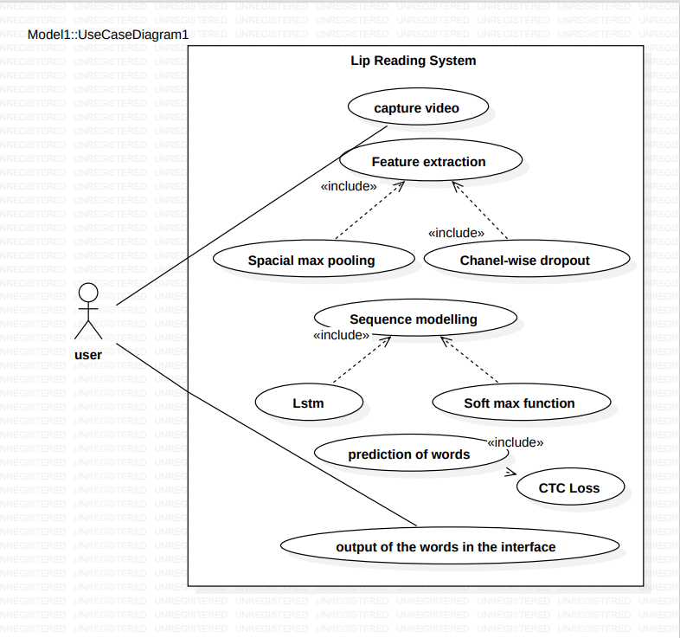
USE CASE DIAGRAM

Slide 40
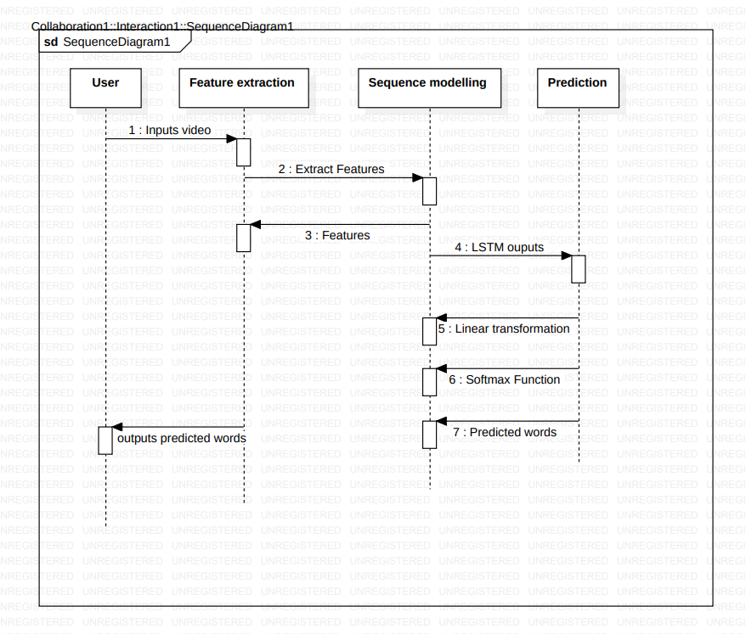
SEQUENCE DIAGRAM

Slide 41
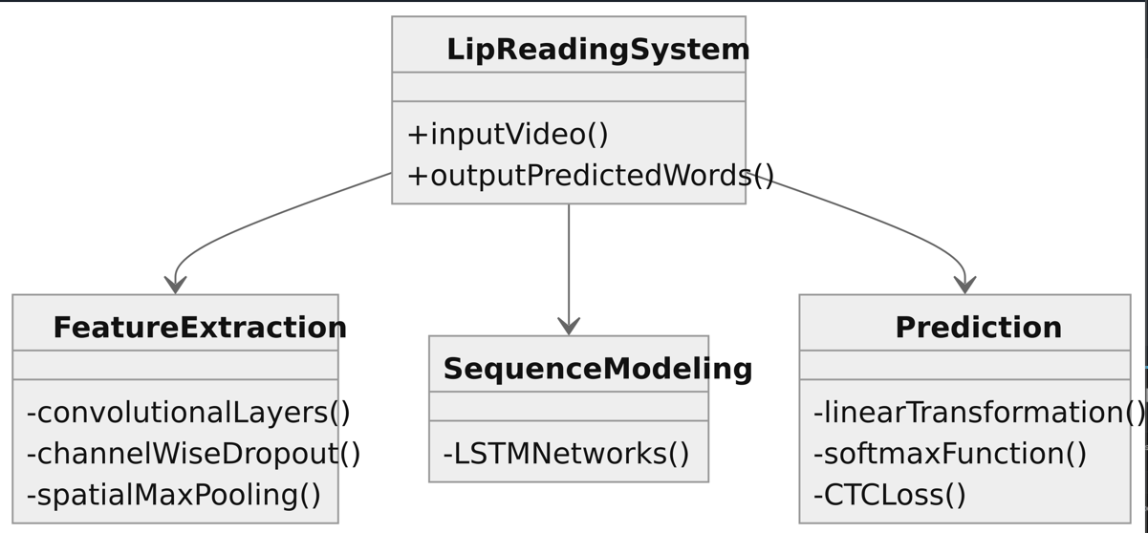
CLASS DIAGRAM

Slide 42
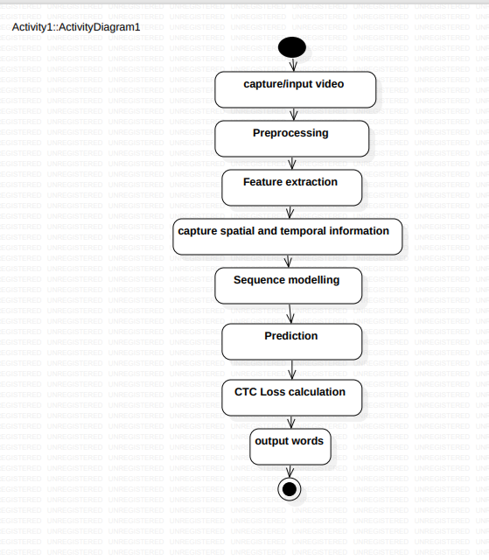
ACTIVITY DIAGRAM

Slide 43
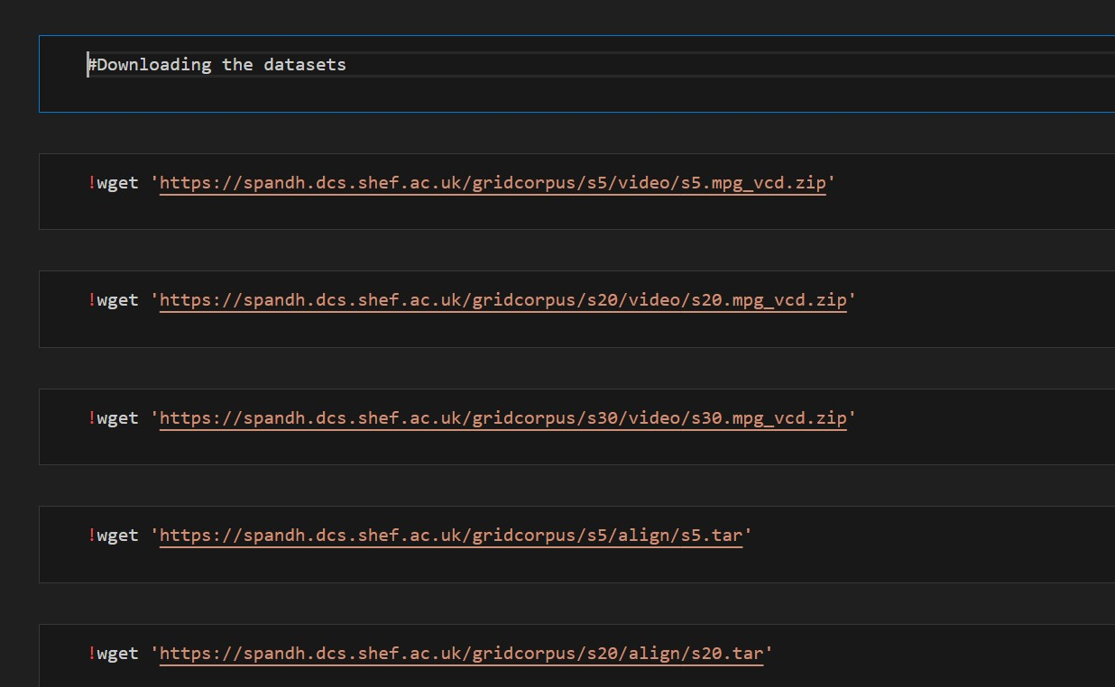
IMPLEMENTATION

Slide 44
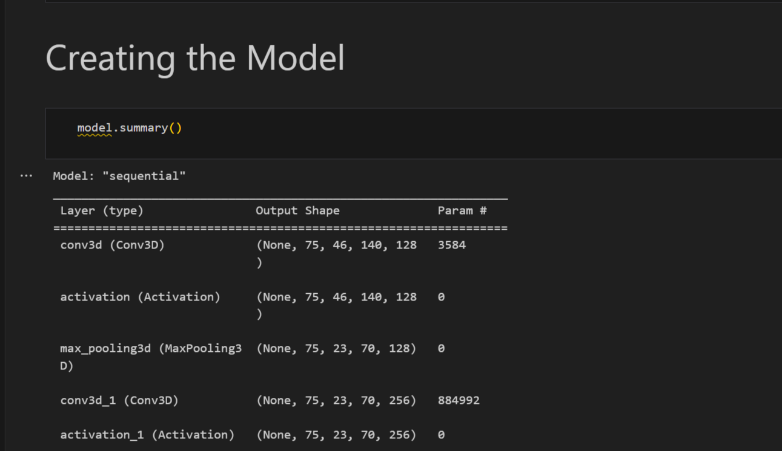

Slide 45
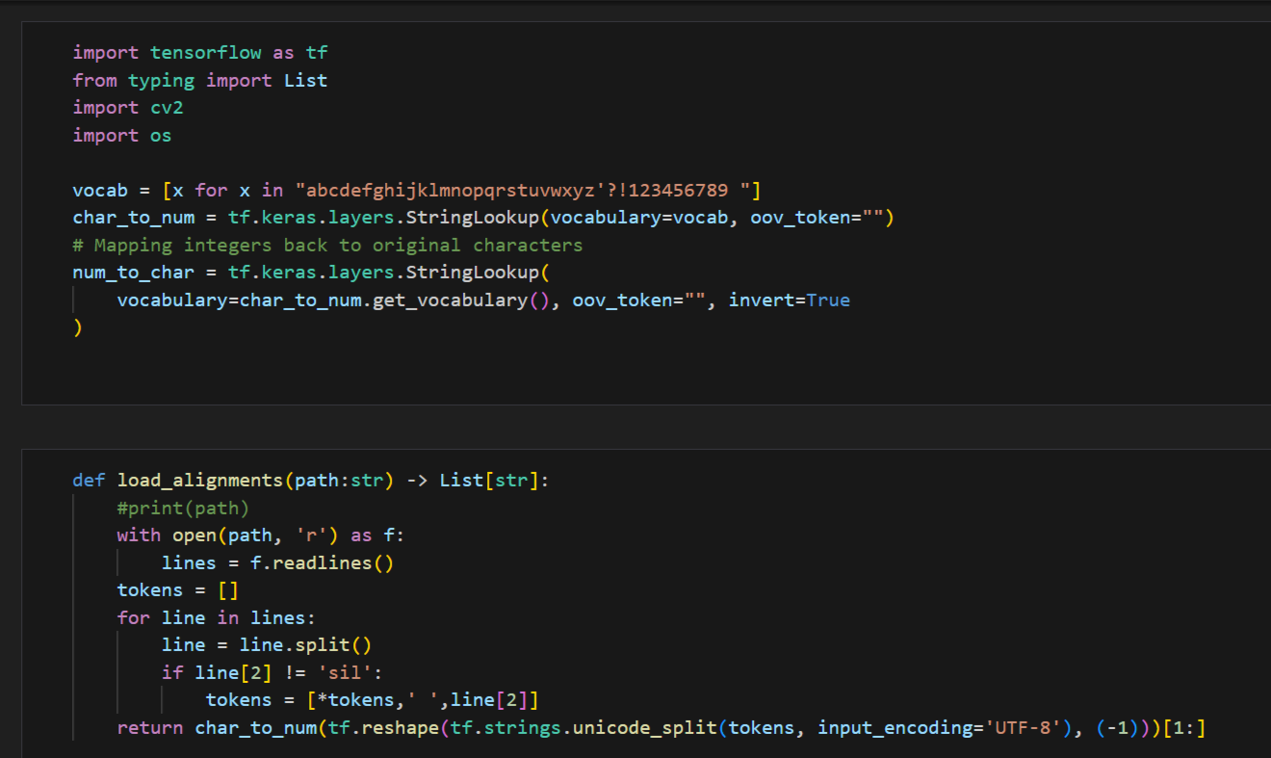

Slide 46
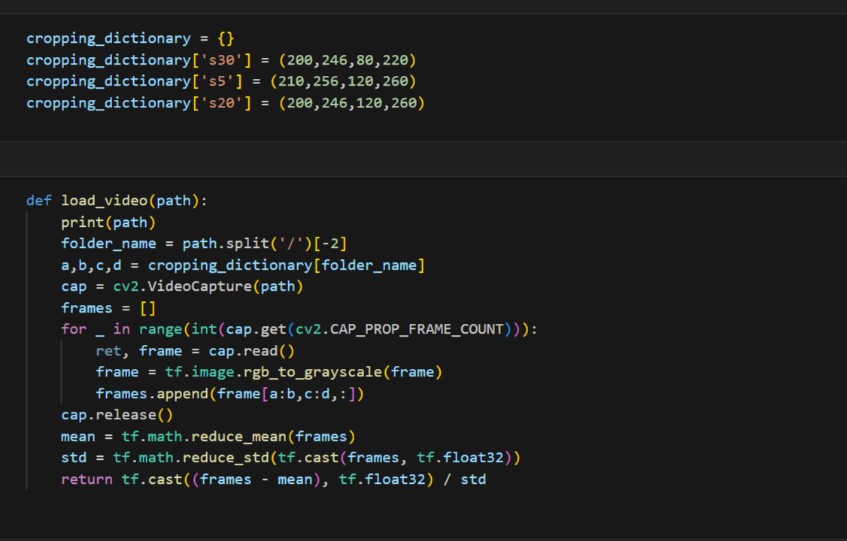

Slide 47
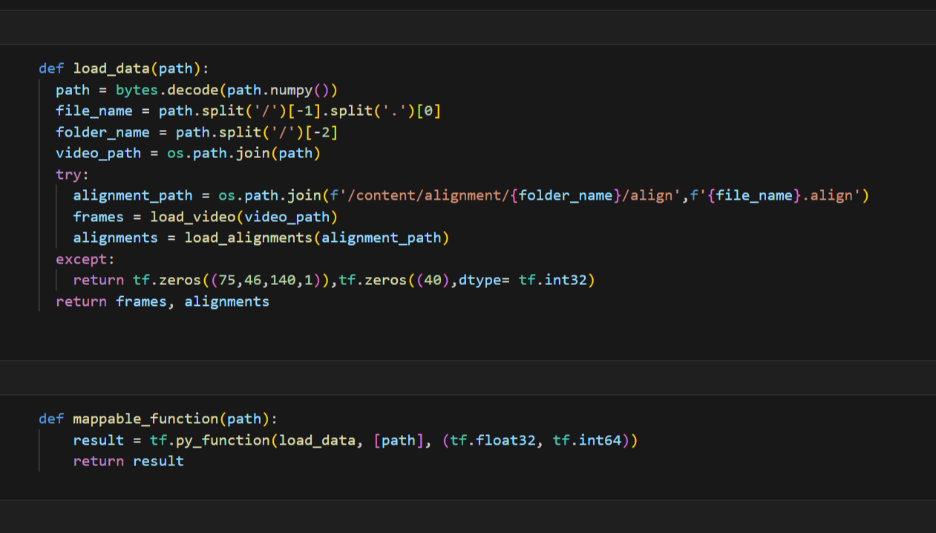

Slide 48
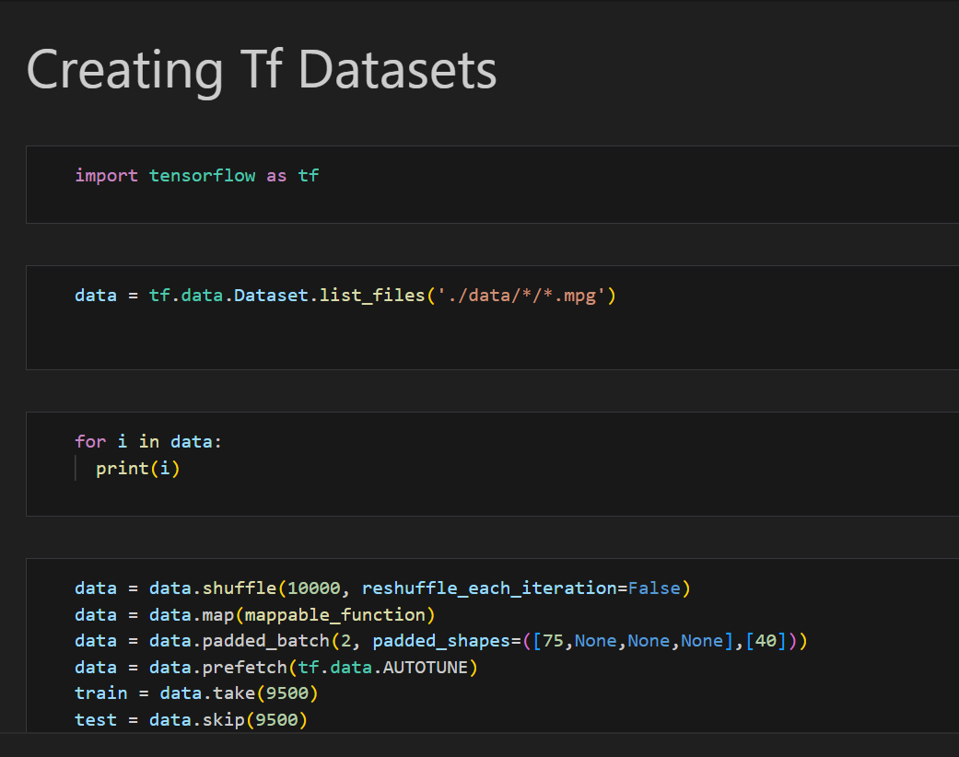

Slide 49
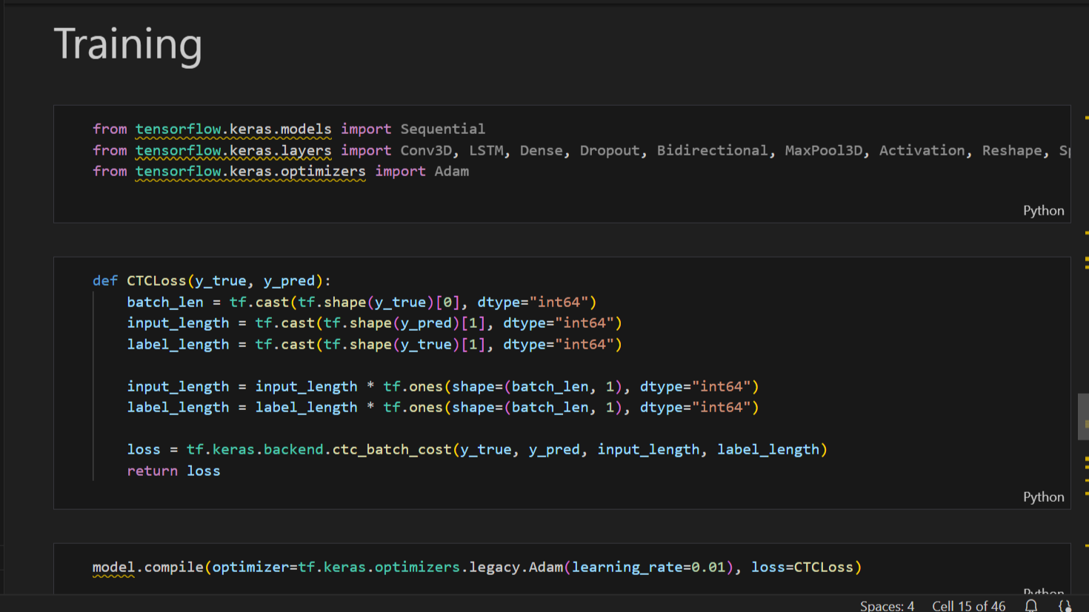

Slide 50
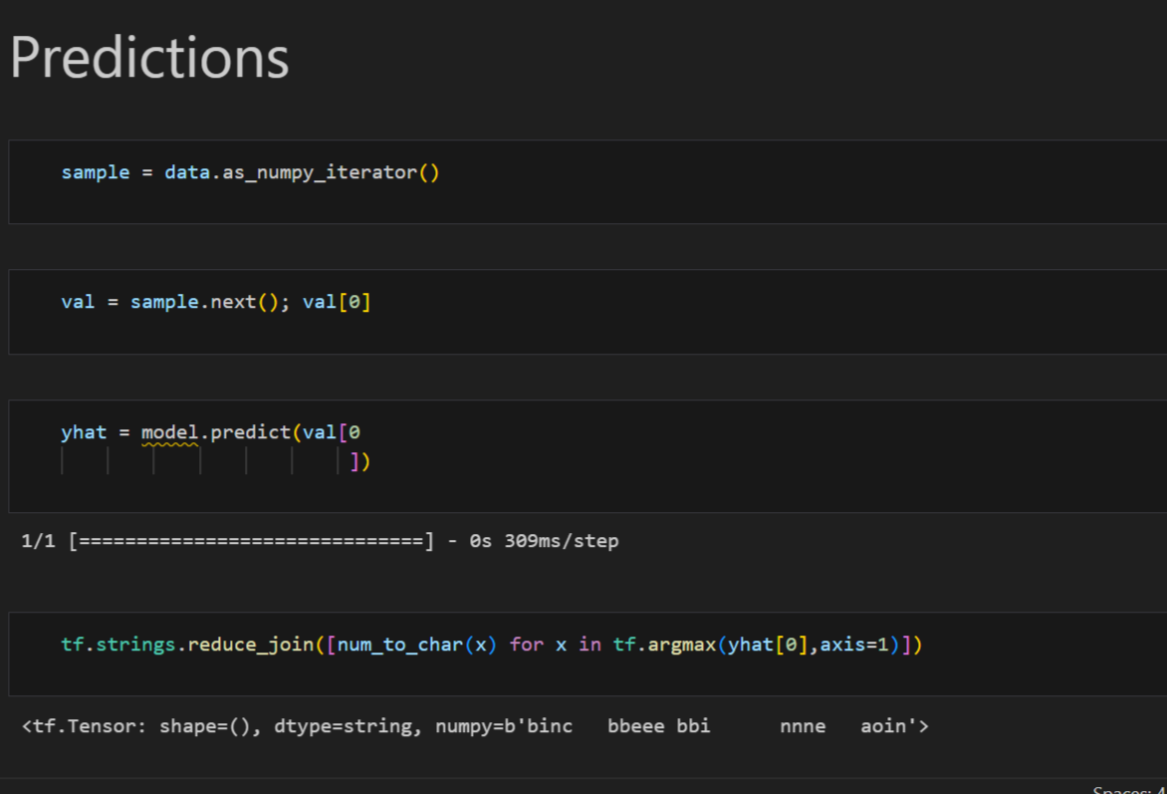

Slide 51
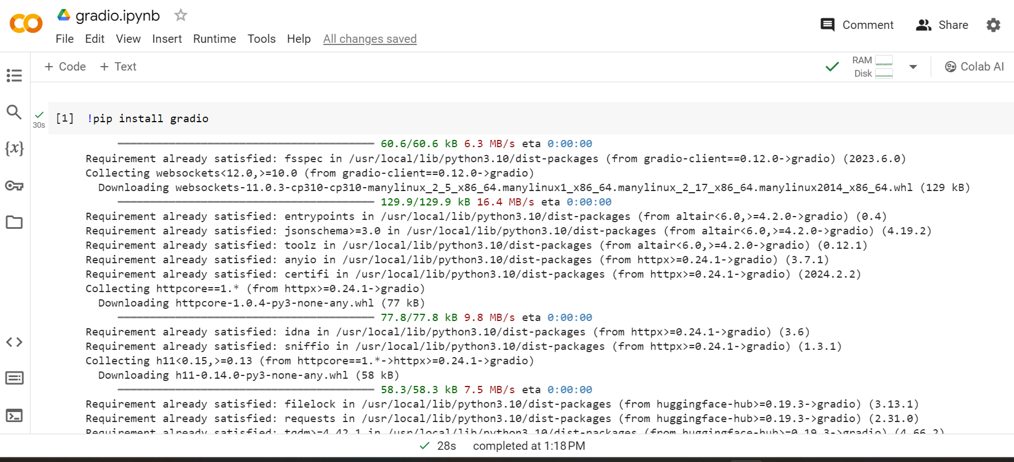

Slide 52
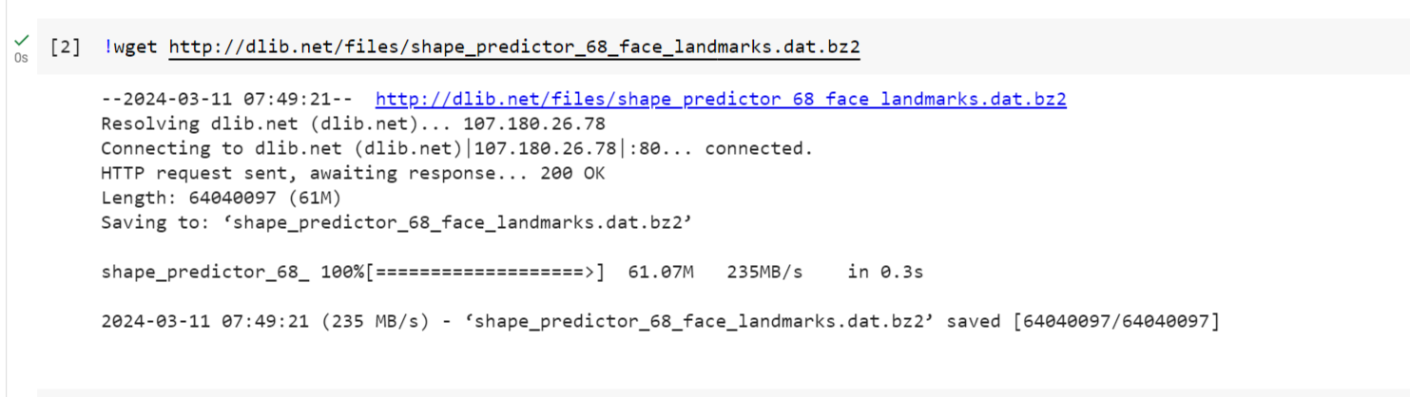

Slide 53
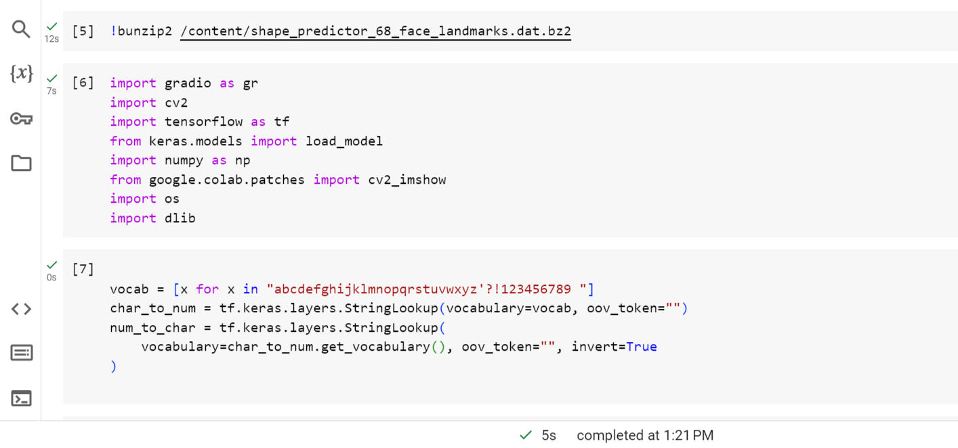

Slide 54
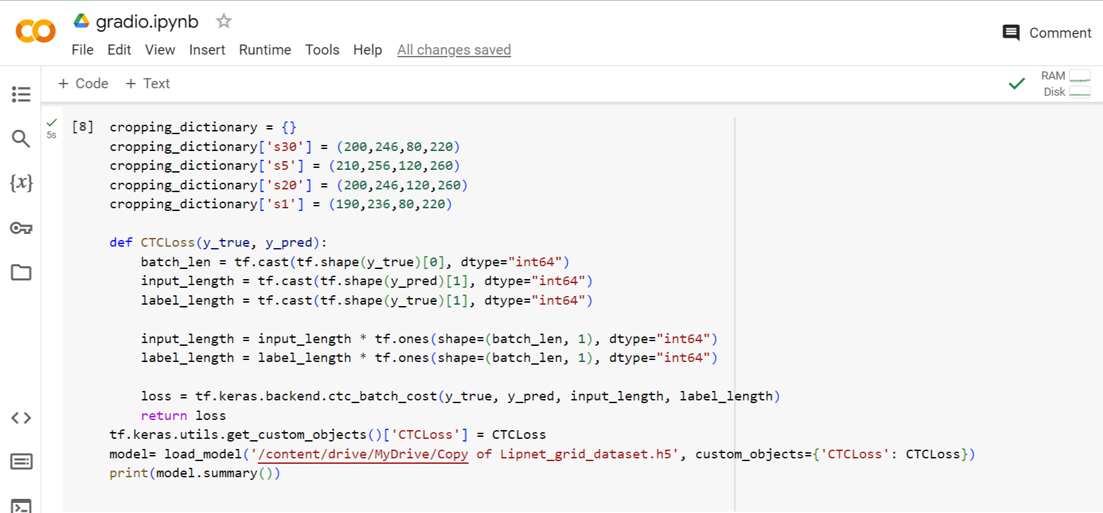

Slide 55
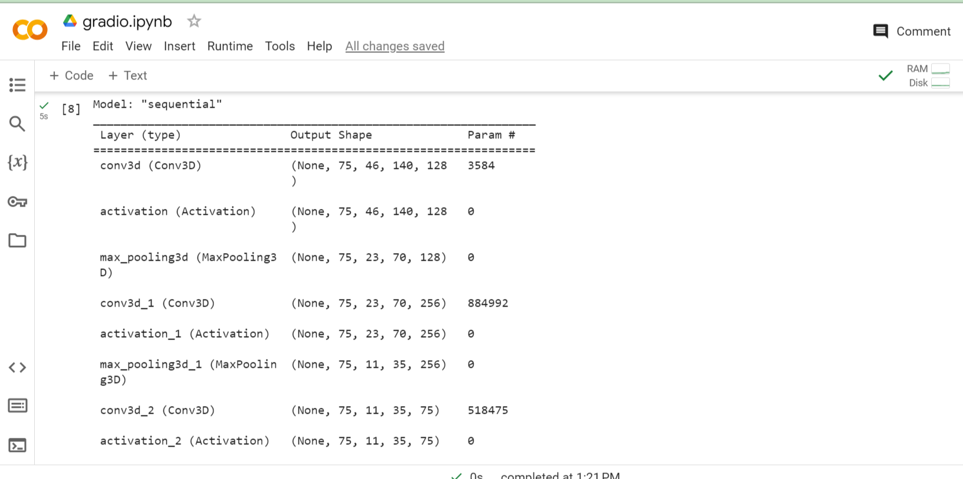

Slide 56
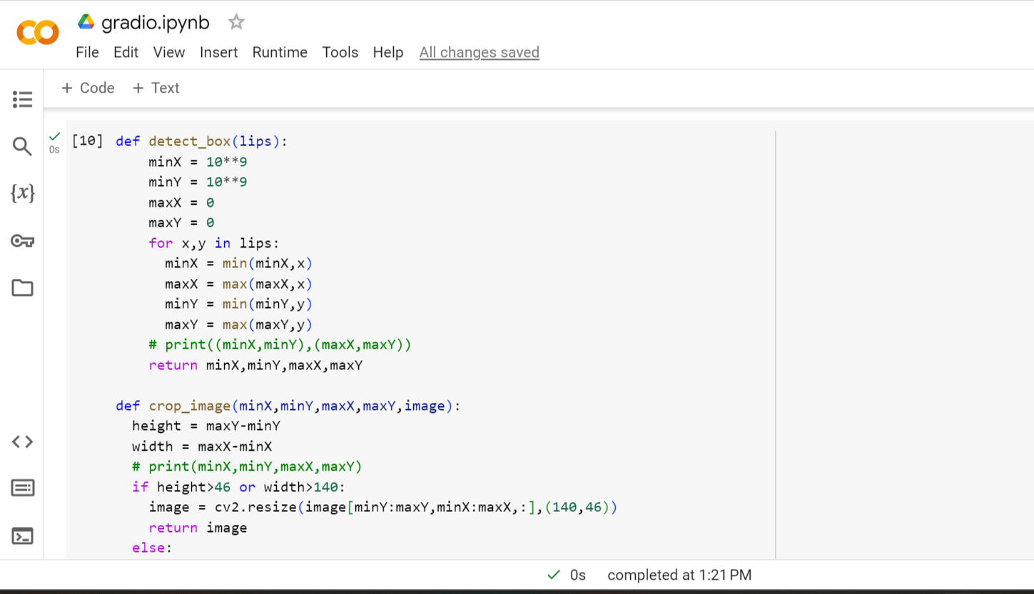

Slide 57
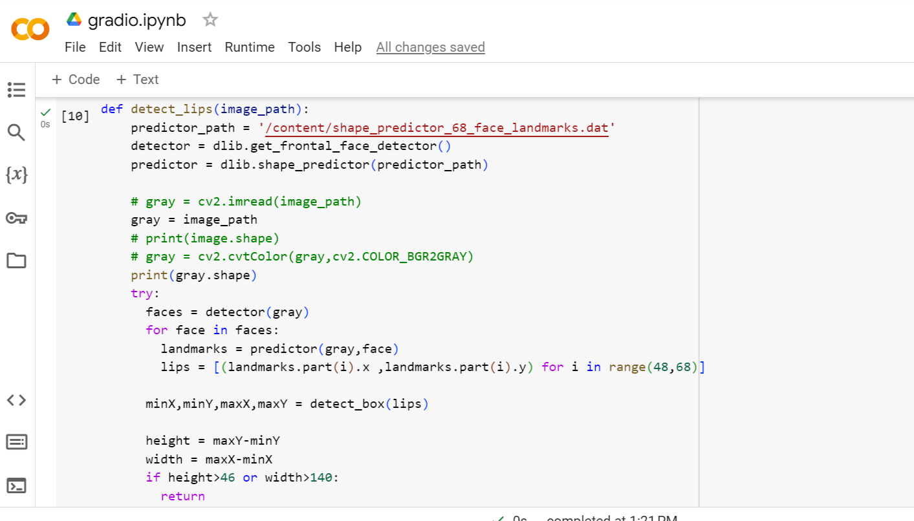
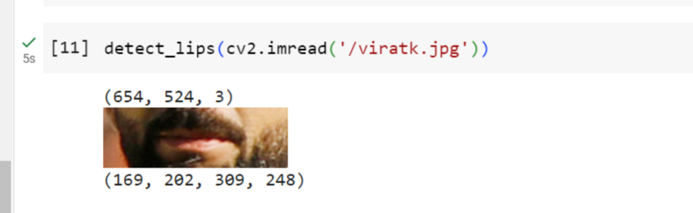

Slide 58
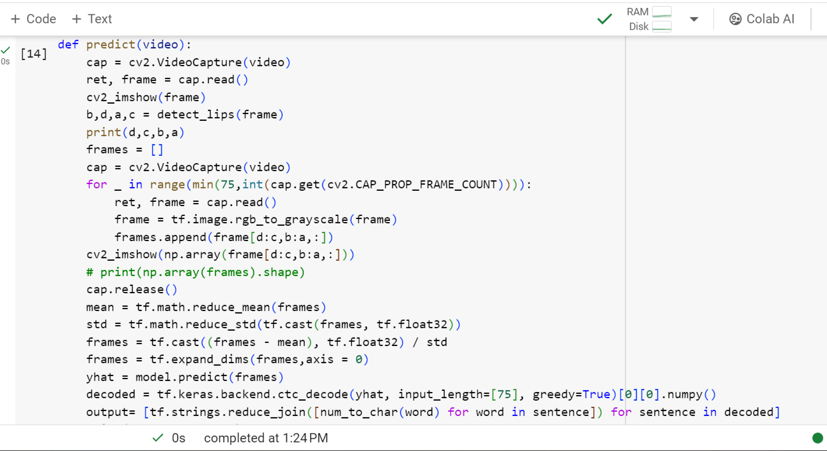

Slide 59
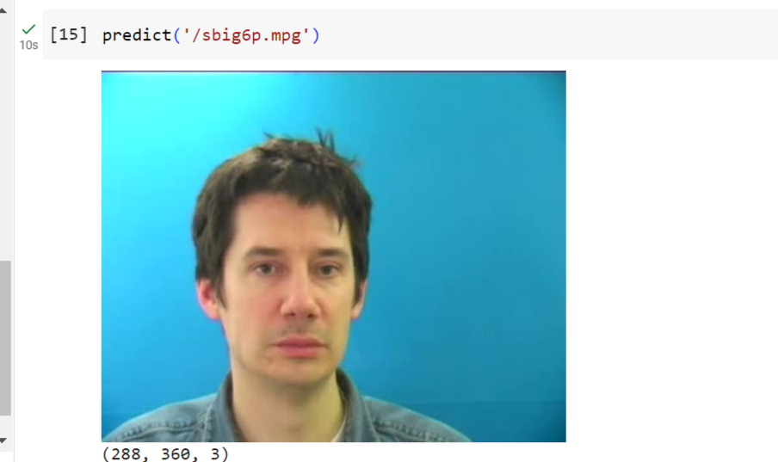
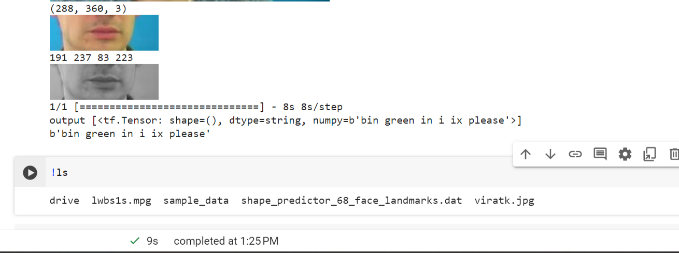

Slide 60
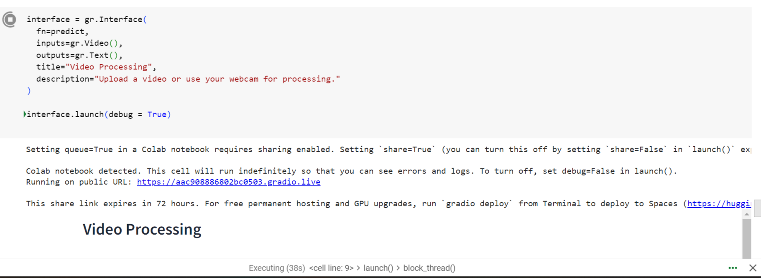

Slide 61
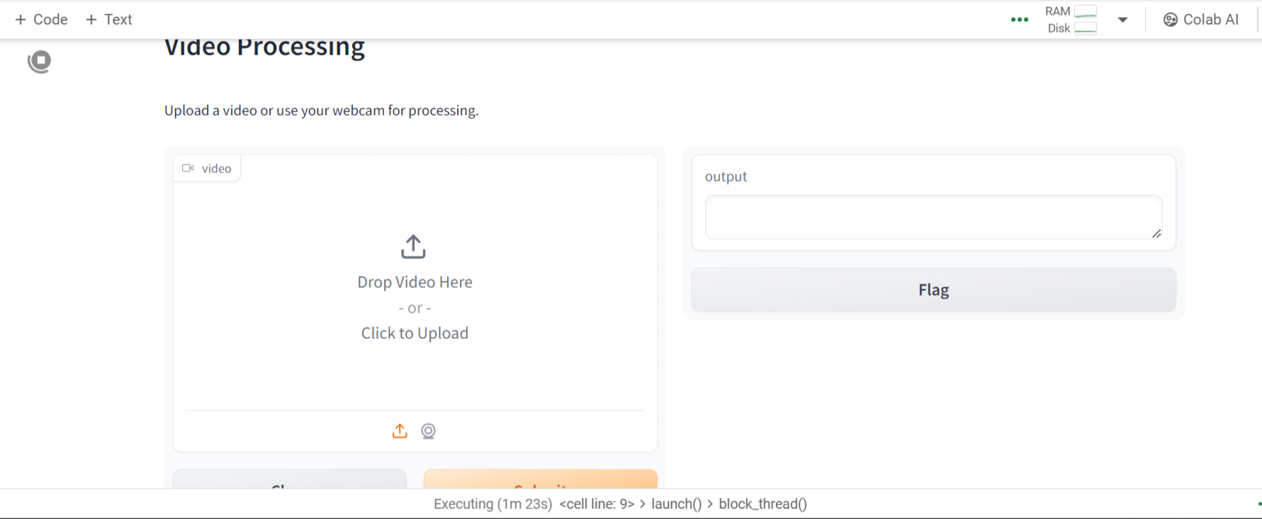

Slide 62
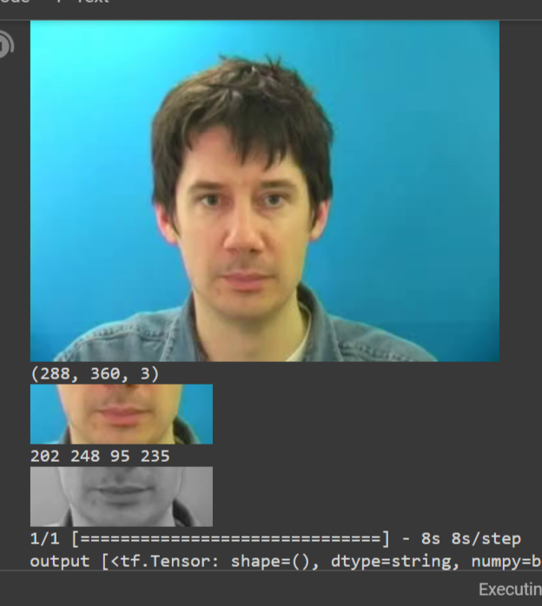
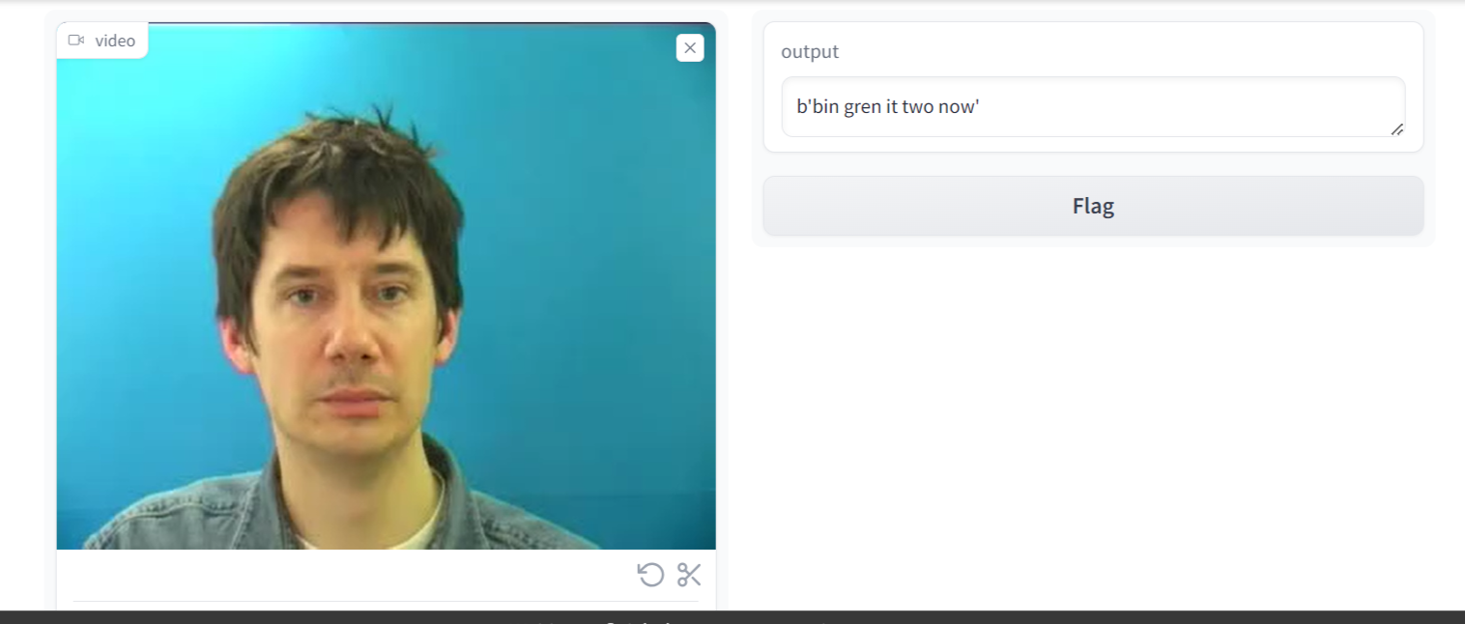
RESULTS

Slide 63
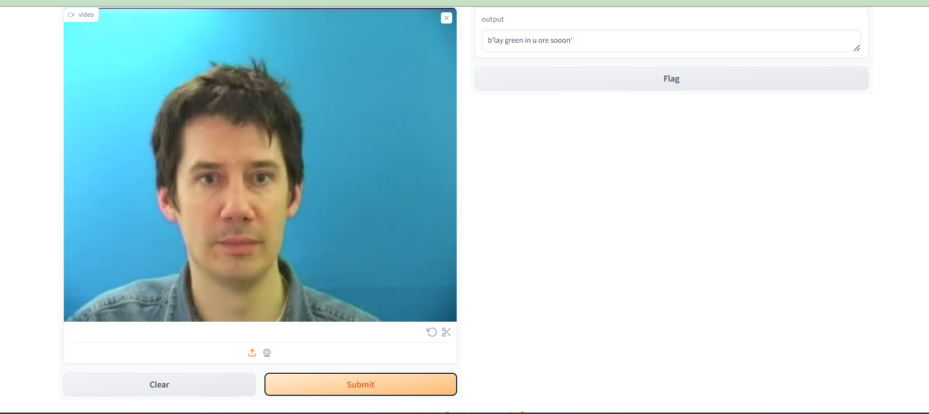
TEST CASES

Slide 64
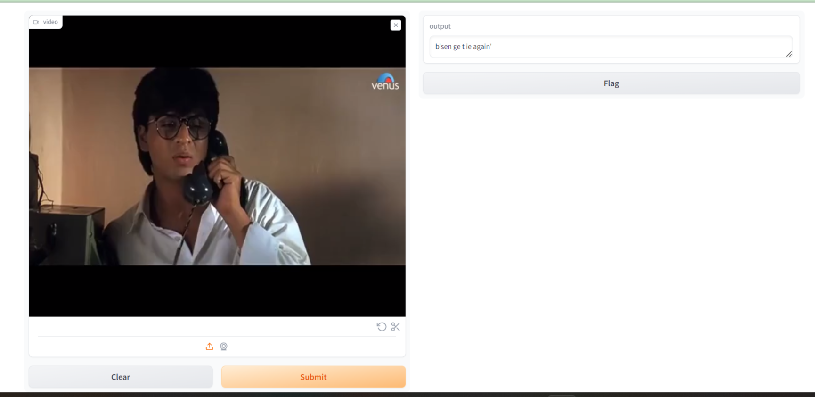

Slide 65
FUTURE SCOPE
Training on videos of 1x and 2x speed: The model can be further improved by incorporating new deep learning architectures and training techniques. Additionally, its robustness to factors such as camera angle and speaking rate can be addressed.
Exploring applications beyond speech recognition: Speech recognition in noisy environments, biometric identification, and silent-movie processing.

Slide 66
References
G. Potamianos, C. Neti, G. Gravier, A. Garg, and A. W.
Senior, “Recent advances in the automatic recognition
of audiovisual speech,” Proceedings of the IEEE, vol.91, no. 9, pp. 1306–1326, Sept 2003.
S. Dupont and J. Luettin, “Audio-visual speech modeling for continuous speech
recognition,” IEEE Trans. On Multimedia, vol. 2, no. 3, pp. 141–151, Sep 2000.
3Z. Zhou, G. Zhao, X. Hong, and M. Pietikainen, “A ¨ review of recent advances in visual speech decoding,” Image and Vision Computing, vol. 32, no. 9, pp. 590– 605, 2014.
4 K. Noda, Y. Yamaguchi, K. Nakadai, H. G. Okuno, and
T. Ogata, “Audio-visual speech recognition using deep
learning,” Applied Intelligence, vol. 42, no. 4, pp. 722–
737, 2015.

Slide 67
1]Martín Abadi, Paul Barham, Jianmin Chen, Zhifeng Chen, Andy Davis, Jeffrey Dean, Matthieu Devin, Sanjay Ghemawat, Geoffrey Irving, Michael Isard, et al. 2016. Tensorflow: A system for large-scale machine learning. In 12th {USENIX} Symposium on Operating Systems Design and Implementation ({OSDI} 16). 265– 283.
Gary Bradski and Adrian Kaehler. 2008. Learning OpenCV: Computer vision with the OpenCV library. " O’Reilly Media, Inc.".
L. Chen. 2016. keras,js. https://github.com/transcranial/keras-js
François Chollet. 2015. Keras documentation. keras. io (2015).
1VSR:
https://youtube.com/playlist?list=PLXkuFIFnXUAPIrXKgtIpctv2NuSo7xw3k
2 G. Fisher. Confusions among visually perceived consonants. Journal of Speech, Language, and Hearing Research, 11(4):796–804, 1968

Slide 68
1 A. V. Omkar M Parkhi and A. Zisserman, “Deep face recognition,” Proceedings of the British Machine Vision, vol. 1, no. 3, p. 6, 2015.
2A. Rekik, A. Ben-Hamadou, and W. Mahdi, “Human machine interaction via visual
speech spotting,” in Advanced Concepts for Intelligent Vision Systems. Springer, 2015, pp. 566–574.
1Martn Abadi, Ashish Agarwal, Paul Barham, Eugene Brevdo, and Xiaoqiang Zheng. Tensorflow: Large-scale machine learning on heterogeneous distributed systems. 2016.
2Triantafyllos Afouras, Joon Son Chung, Andrew Senior, Oriol Vinyals, and Andrew Zisserman. Deep audio-visual speech recognition. IEEE Transactions on Pattern Analysis and Machine Intelligence, 2018.
3Triantafyllos Afouras, Joon Son Chung, and Andrew Zisserman. The conversation: Deep audio-visual speech enhancement. arXiv preprint arXiv:1804.04121, 2018

Slide 69
9Shaojie Bai, J Zico Kolter, and Vladlen Koltun. An empirical evaluation of generic convolutional and recurrent networks for sequence modeling. arXiv preprint arXiv:1803.01271, 2018.
10William Chan, Navdeep Jaitly, Quoc Le, and Oriol Vinyals. Listen, attend and spell: A neural network for large vocabulary conversational speech recognition. IEEE International Conference on Acoustics, Speech and Signal Processing (ICASSP), pages 4960–4964, 2016.
16Makino, T. et al. Recurrent neural network transducer for audio-visual speech recognition. In Proceedings of the IEEE Automatic Speech Recognition and Understanding Workshop, 905–912 (2019).
17Serdyuk, D., Braga, O. & Siohan, O. Transformerbased video front-ends for audio- visual speech recognition for single and multi-person video. In Proceedings of the 23rd Annual Conference of International Speech Communication Association, 2833–2837 (2022).
J. S. Chung, A. Senior, O. Vinyals, et al., “Lip reading sentences in the wild,” in Proceedings of the 30th IEEE/CVF Conference on Computer Vision and Pattern Recognition, 2017, pp. 3444–3453.

Slide 70
THANK YOU

